Slide 1
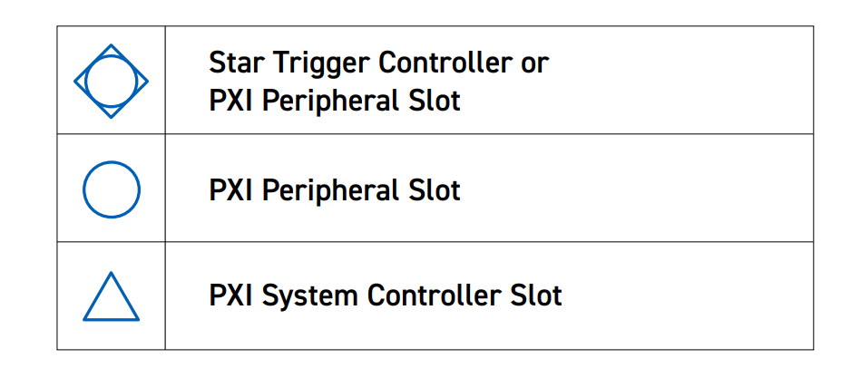
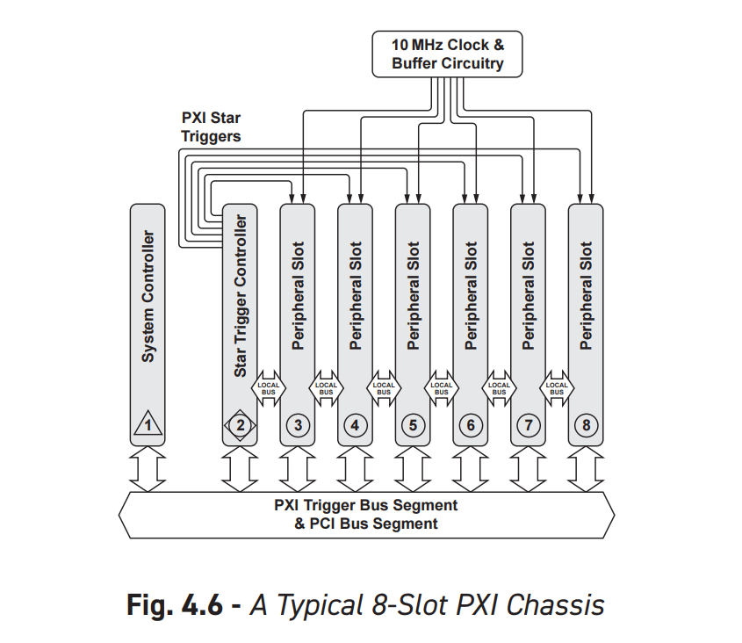
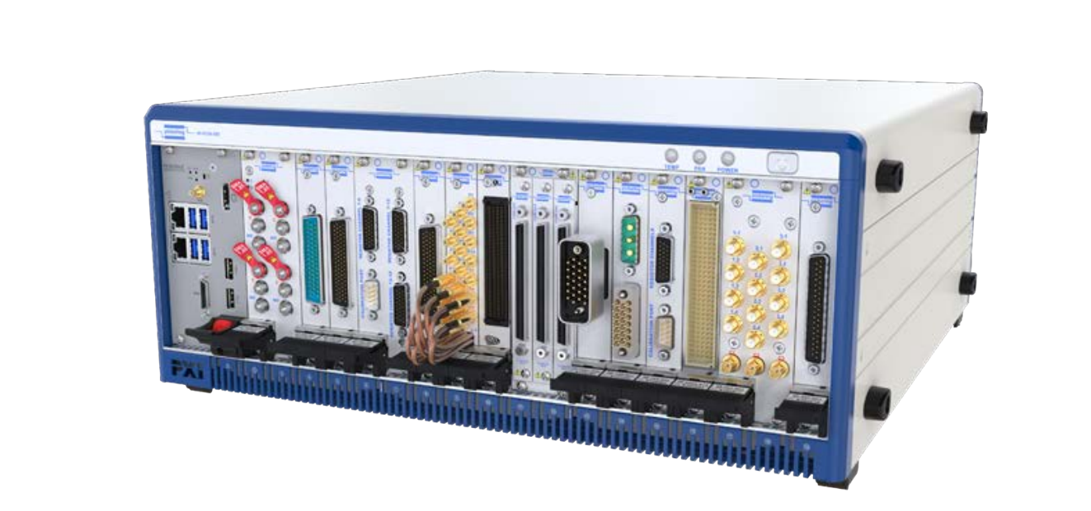
PXI Overview: Chassis
Chassis
Special slot for controller or remote control card
Special slot for star trigger (optional)
The rest are peripheral slots
Power
Cooling
Isolated ground

Slide 2
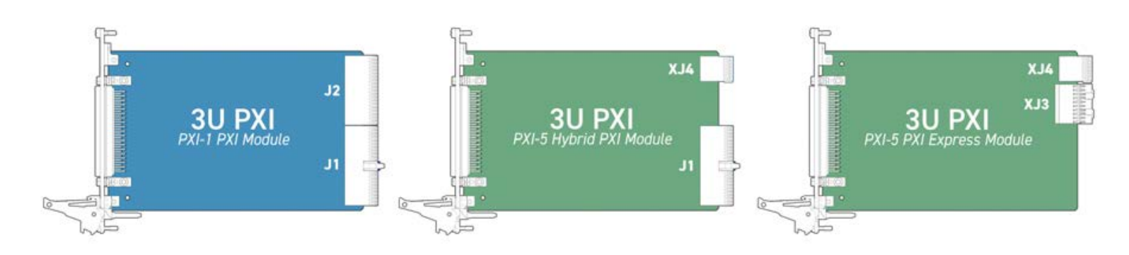
PXI Overview: Slot types
PXI was based on PCI
PXIe is based on PCIe
PXI-H hybrid slot supports both PXIe and PXI
PXIe did not obsolete PXI – both still used
PXIe is used for high-speed measurements
Physical size
3U
6U
May take up multiple slots

Slide 3
Minimum requirements to build a test
Voltage measurement
We mean open circuit voltage typically
Resistance measurement
Can tell you more about connection than open circuit voltage
Arbitrary voltage source
Turn devices on and off
Turn relays on
Avoid using for continuity tests, prefer resistance tests
Current measurement (rare)
Being able to construct arbitrary circuits
Notes:
First, those are minimum requirements to write tests. You want to measure voltage and resistance. Ideally, we would always measure resistance because it is more accurate, but it’s not always possible. Measuring an open circuit voltage on a pin, for example, tells you that it’s the correct potential, but does not tell you if it’s a high resistance connection (poor crimp, not seated terminal, etc…). Resistance test is more accurate, but it may not be possible because we don’t have access to both ends of the wire, or if there’s current going through the wire. Voltage measurement is used to test relays outputs, where as resistance measurement is used from grounds, and in places where we have access to both ends of the wire. There’s an additional requirement here: an arbitrary adjustable voltage source. This is important, because it can make it very easy to build tests if you could generate an arbitrary voltage on command. In circuit analysis, a test voltage source is an important measurement tool that can be used to characterize a circuit. For example, you may apply a test voltage source and measure current to find out impedance. Current measurement may be important for testing certain components, such as verifying sensor current sources, measuring output or input impedance, estimating power consumption. It’s important when you need it, but for Tiger may be optional. Last requirement, you want to be able to construct arbitrary test circuits in software. In this is the topic of the next series of slides.

Slide 4
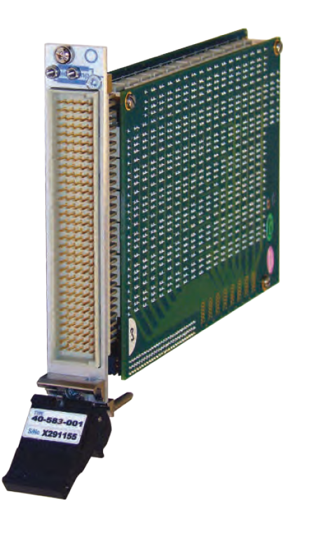
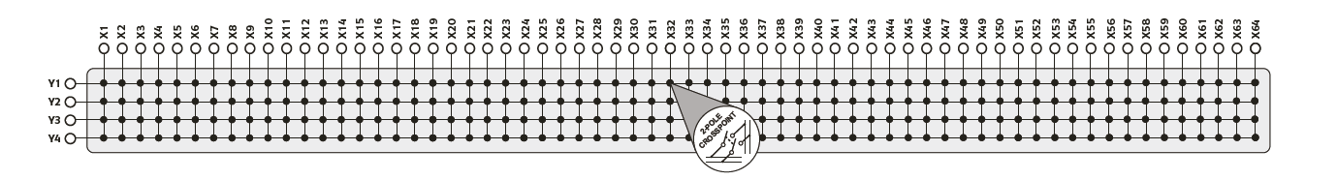
Matrix PXI Modules
Grid arrangement of relays
Each cross-point is a relay connecting row and column
Notes:
To build arbitrary circuits we need a matrix. Matrix is a grid arrangement of relays. Typically still uses PCI(not PXIe)

Slide 5
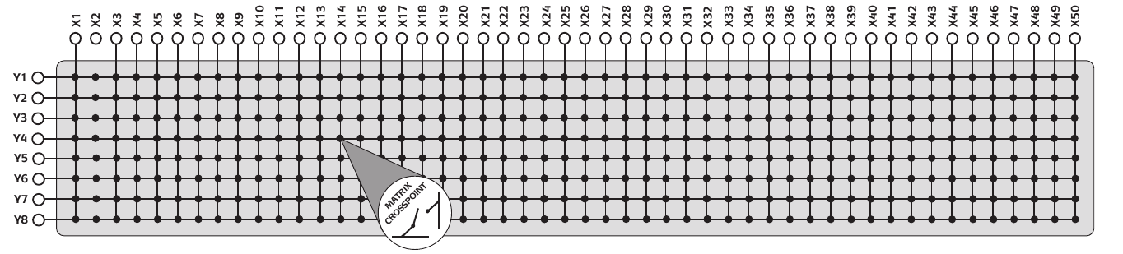
How to perform routing using a matrix?
Each matrix has a long X dimension and a shorter Y dimension
You may try to place test resources such as DMM and voltage sources on a short axis
You will find this has shortcomings!
Instead, just place all nodes on X axis
Much simpler and it will work…
X
Y
Notes:
How do you use a matrix to build tests? When you look at different modules, the first thing you notice they have one short and one long dimension. You may try to put your scarce resources such as DMM probes or voltage sources on the short dimension and then put the device under test pins on the long dimension. This would work to a point, but soon you will realize you may want to duplicate some test resources onto the long axis to be able to build more types of circuits. Ultimately you can duplicate all your resources and have an 8x8 square dedicated to test resource pins. This has one problem though: the number of test resources must be less than the Y dimension of the matrix. Additionally, if you have more Y rows than the test resources you don’t have a way of using the extra rows, they are just dead wait.

Slide 6
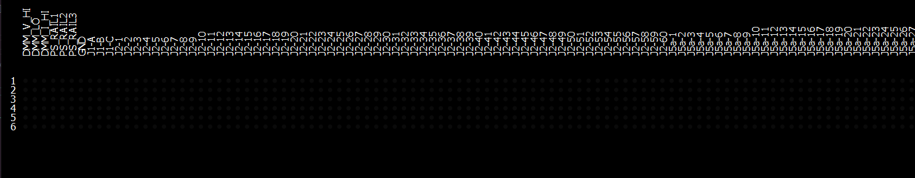
How to perform routing using a matrix?
The long axis is assigned to both Device Under Test (DUT) and test resource nodes.
Do not place anything on Y axis…
… until it is time to route!
X
Y

Slide 7
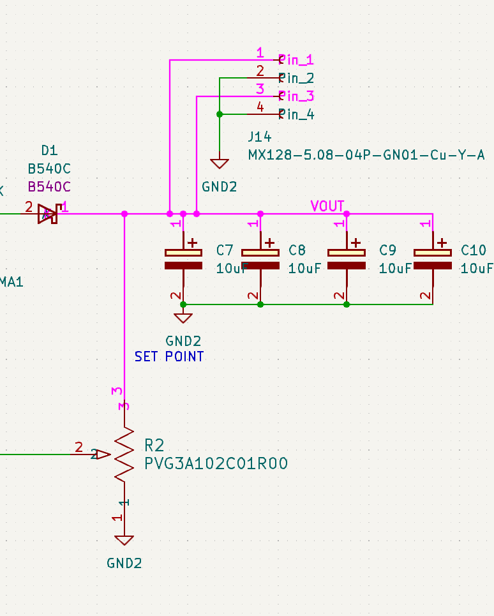


Aside Q: What is a net? A: A net is a description of connectivity.
Formally, a net is a set of connected nodes.
Circuit may contain multiple nets.
Nets are disjoint sets, meaning a node can only belong to one net.

Slide 8
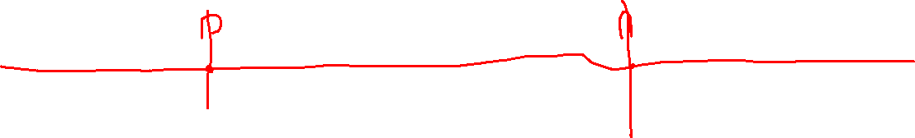
How to perform routing using a matrix?
Use Y-axis rows to make arbitrary connections between X-axis columns
Each net requires a single row
Notes:
The best way to route using a matrix is to keep track of nets. Each net requires a single row to implement it. For each net, select a row. Go over each node in the net and find the intersection of its column with the row. Turn the relay at intersection on to connect it. Each row acts as a set and by connecting columns to it you add it to the set.

Slide 9
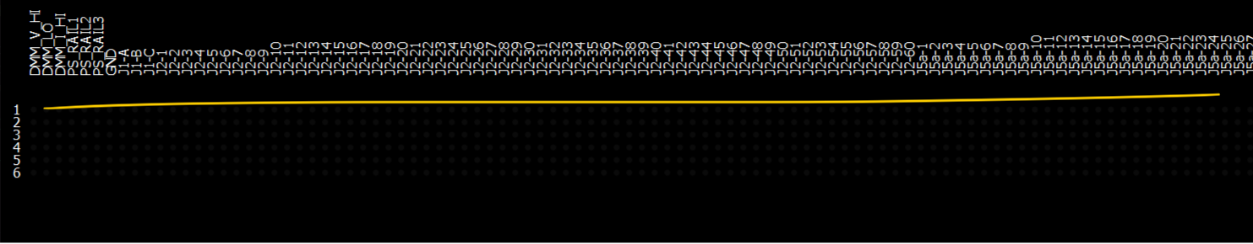
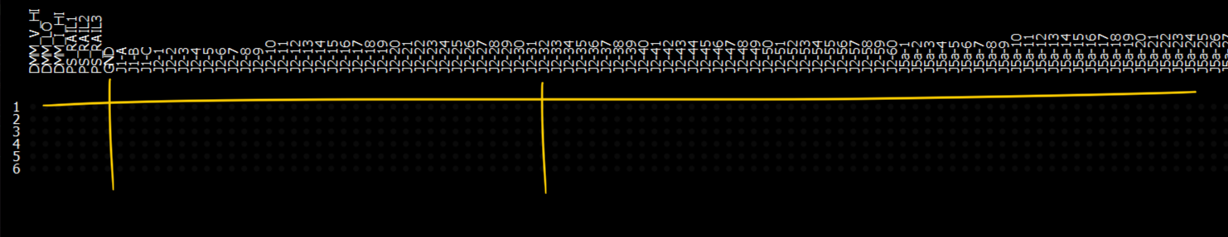
Example: Connect J2-32 to GND
Pick an unused row
Intersect J2-32 column with the row
Turn the relay at intersection on

Slide 10
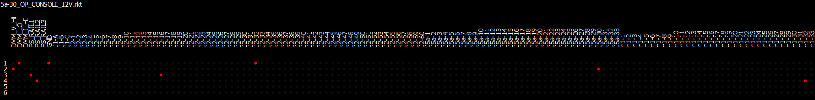
How big does the matrix need to be?
Tiger control box requires 204 targets
In addition to 7 tester targets
For a total of 211 targets on X-axis
Y-axis requirements depend on number of simultaneous nets in a test
Maximum Y-axis usage was 4 in simulations
(Actual maximum row usage was 5 with no optimizations)
A Y-axis of 6 would be preferred.

Slide 11
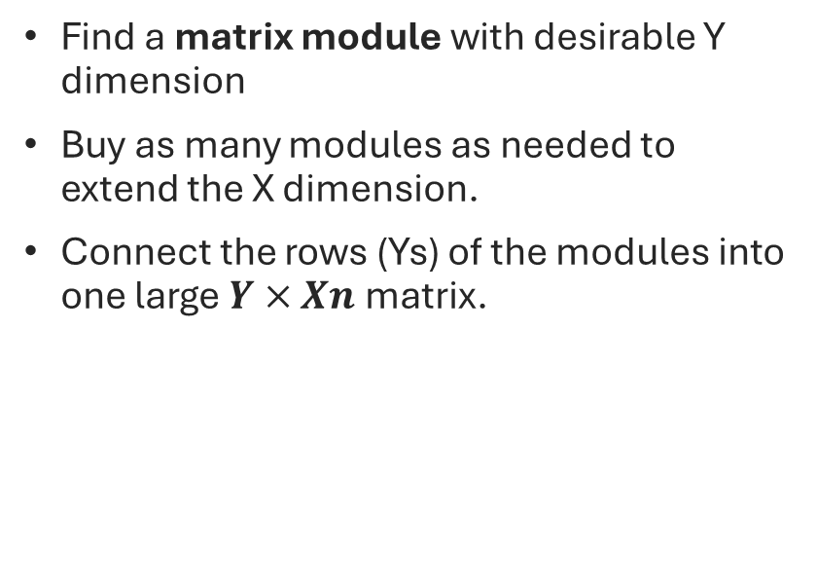
Extending a matrix
Find a matrix module with desirable Y dimension
Buy as many modules as needed to extend the X dimension.
Connect the rows (Ys) of the modules into one large $Y×Xn$ matrix.
Notes:
This matrix is ending up very long. Where do you get a matrix with over 200 columns? You get one by connecting rows of smaller matrices.

Slide 12
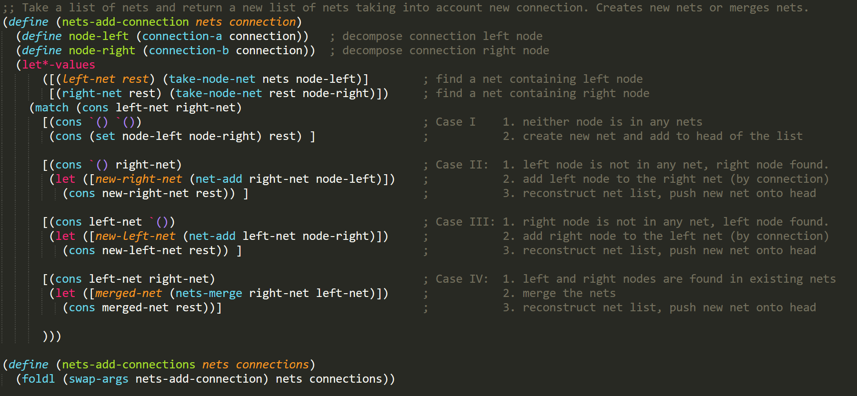
Build your own matrix router in two LISP calls:
Routing matrix was implemented in LISP in two functions
First one builds nets from connections
A (connection a b) is a binary relation between two nodes

Slide 13
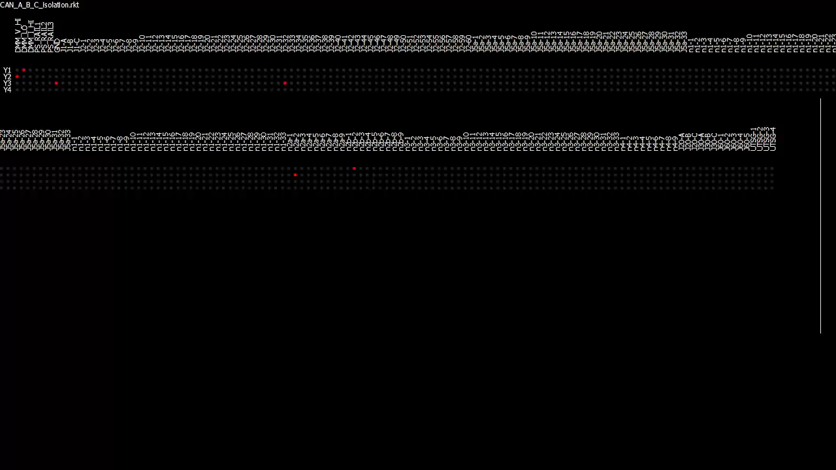
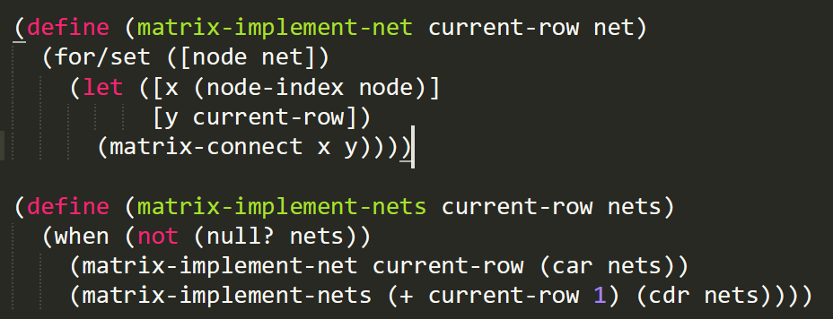
Build your own matrix router in two LISP calls:
Second one, flips the relays on…

Slide 14

Test resource nodes
The 7 test targets are dedicated to test resources
DMM_V_HI is Voltage Probe +
DMM_LO is DMM Ground
DMM_I_HI is DMM Current Probe +
PS_RAIL1,2,3 are adjustable power supply controlled by the test
GND

Slide 15
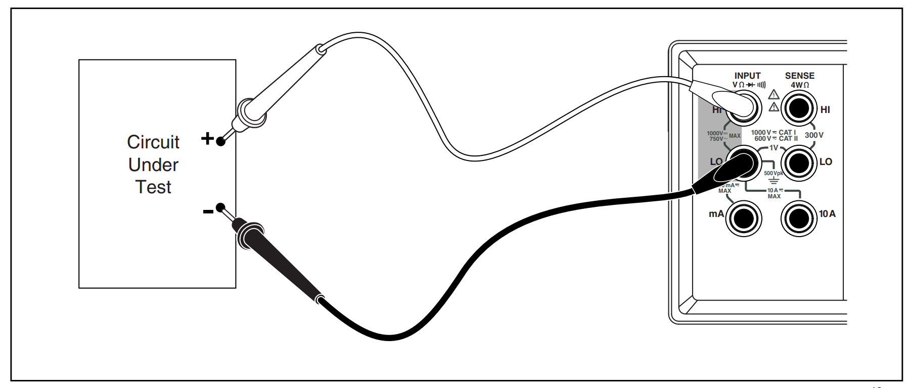
Test resource nodes
DMM_V_HI
DMM_LO
DMM_I_HI

Slide 16
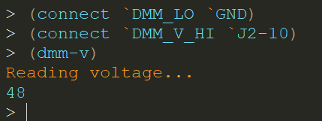
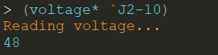
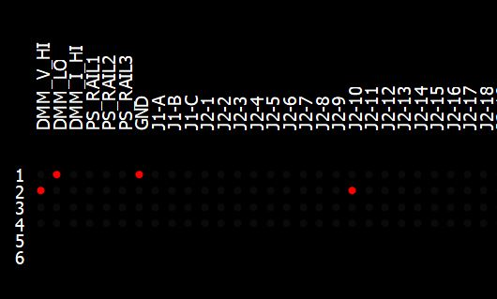
Making a basic voltage measurement
Note on LISP syntax:
Calling a function
(<function name> arg1 arg2 …)
Symbol syntax
`<symbol> also ‘<symbol>
COST: 2 ROWS

Slide 17
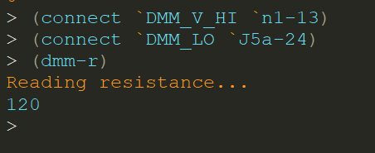
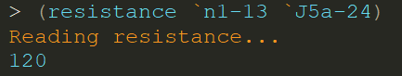
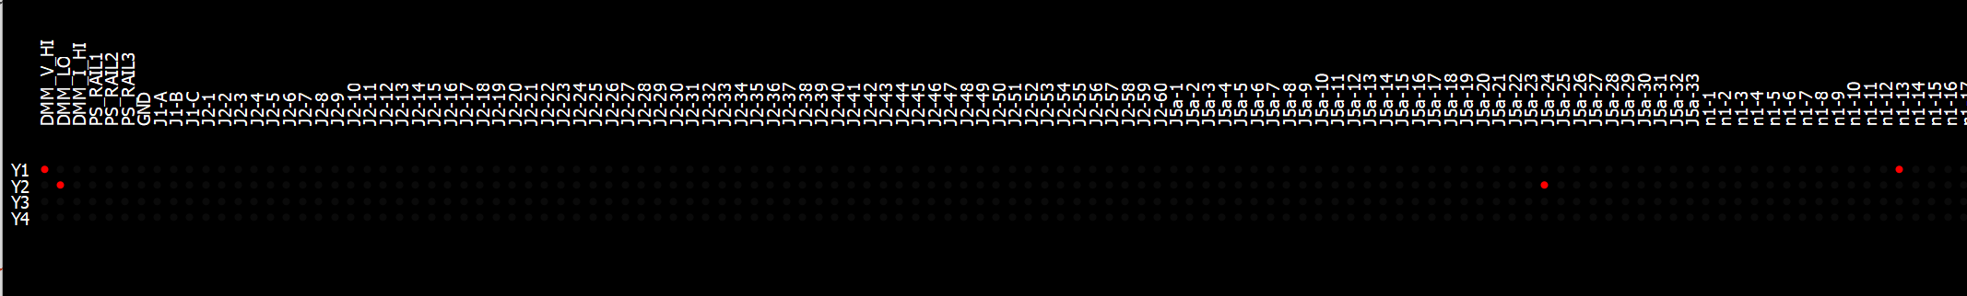
Making a basic resistance measurement
COST: 2 ROWS

Slide 18
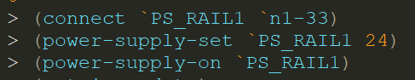
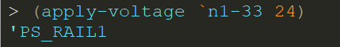
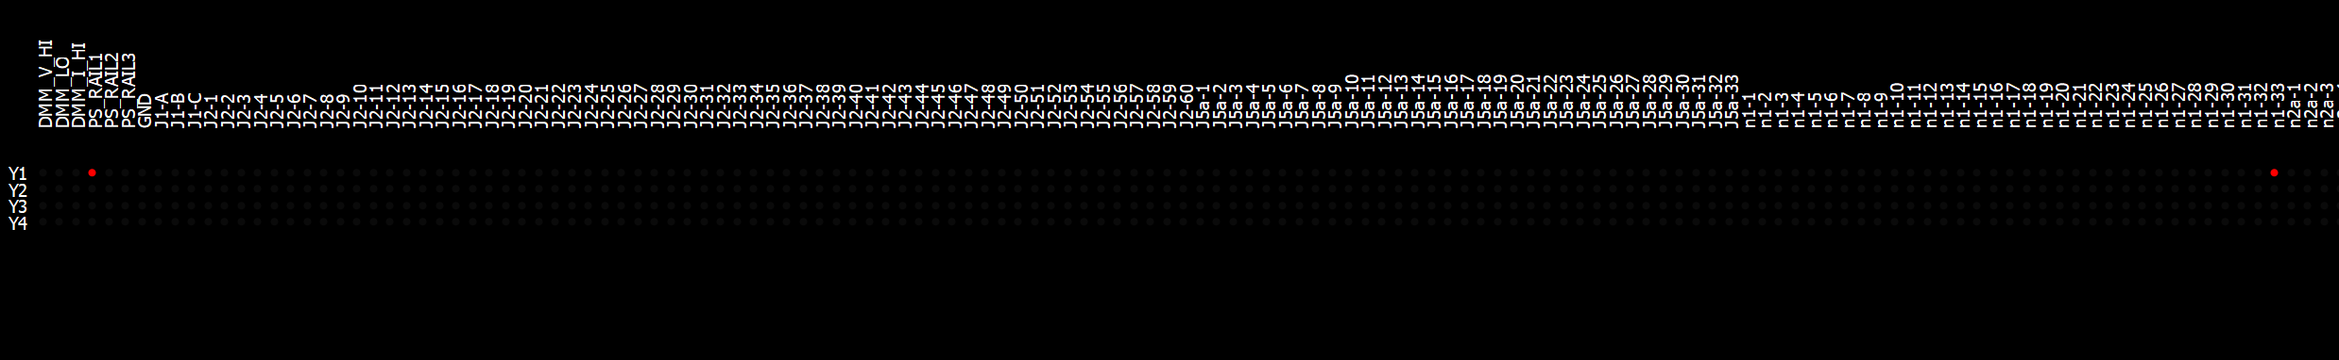
Applying a voltage signal
COST: 1 ROW

Slide 19
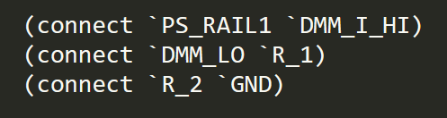
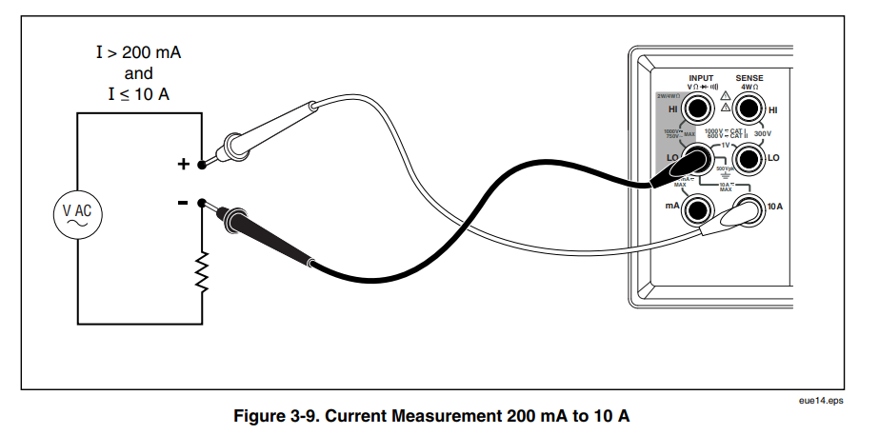
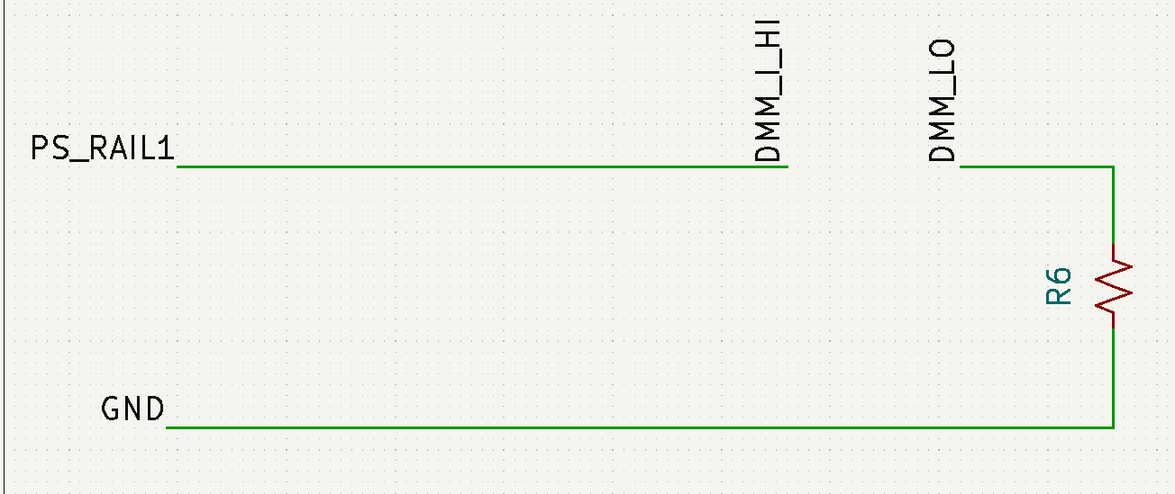
Performing a current measurement (not used for Tiger)
COST: 3 ROWS

Slide 20
Test language
connect two nodes a and b together
measure voltage between a and b nodes
measure resistance from a to b
apply-voltage v to node a
Connectivity | Power | Measurement
(connect a b) | (power-supply-set rail v) | (dmm-v)
(disconnect a b) | (power-supply-on rail) | (dmm-i)
(disconnect-all) | (power-supply-off rail) | (dmm-r)
 | (apply-voltage a v) | (voltage a b)
 | (remove-voltage a) | (resistance a b)
 | (apply-ground a)

Slide 21
Test language
connect two nodes a and b together
Take dmm-voltage reading depending on where DMM_V_HI and DMM_V_LO are connected
Take dmm-resistance reading depending on where DMM_V_HI and DMM_V_LO are connected
Manually control power-supply nodes with …-set, on, off
Connectivity | Power | Measurement
(connect a b) | (power-supply-set rail v) | (dmm-v)
(disconnect a b) | (power-supply-on rail) | (dmm-i)
(disconnect-all) | (power-supply-off rail) | (dmm-r)
 | (apply-voltage a v) | (voltage a b)
 | (remove-voltage a) | (resistance a b)
 | (apply-ground a)

Slide 22
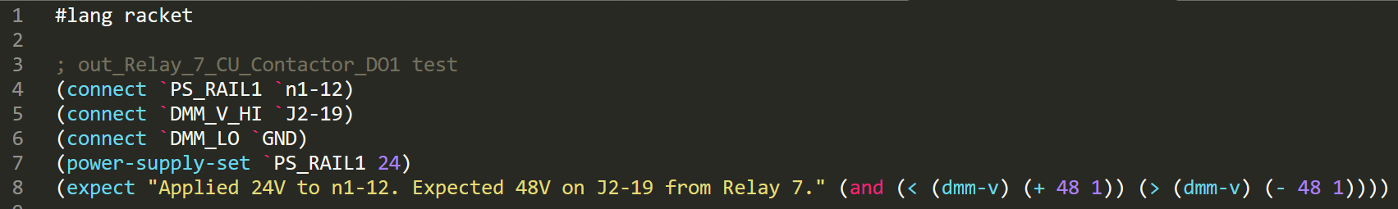
Expect is way of asserting correct behavior
expect takes a message and Boolean expression
expect fails the test when the Boolean expression is false and returns an error message to the test system.

Slide 23
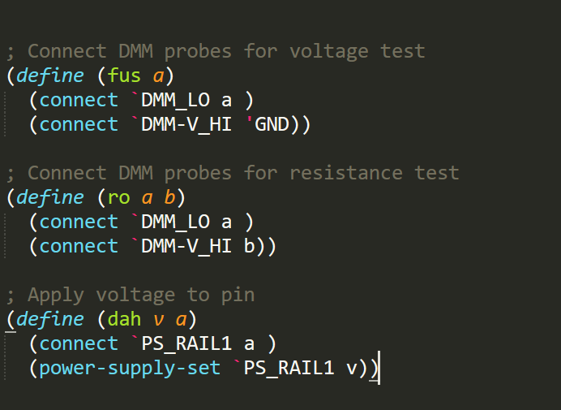

Simplifying common patterns
We can define more shorthand calls to simplify common patterns

Slide 24
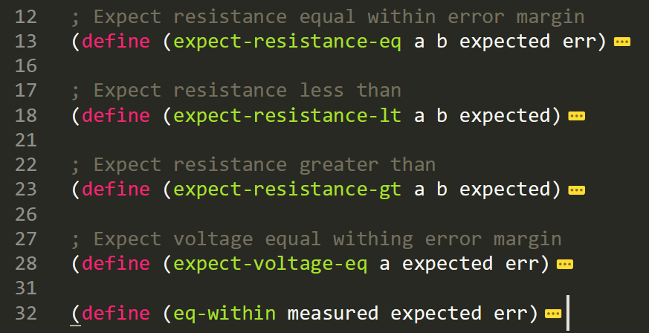
Simplifying common patterns
We can define more shorthand calls to simplify common patterns

Slide 25
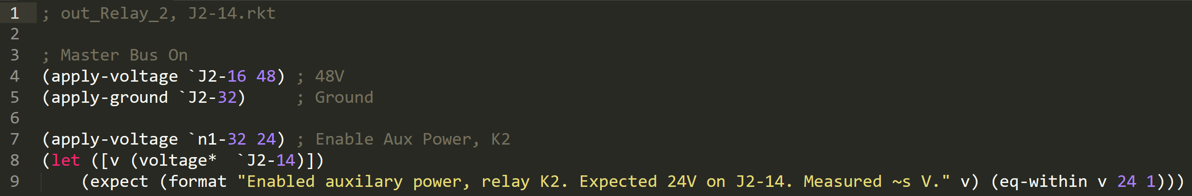
Real test examples: KSI Relay
Applies 48V and GROUND to turn control box “on”.
Applies voltage to coil of relay K4
Reads voltages at various relay outputs
Expects read voltage to be 48V +/- 1V
Return error message if voltage is out of range

Slide 26
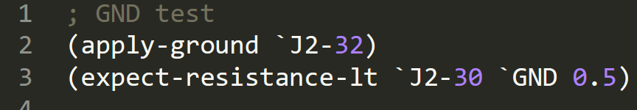
Real test examples: Ground test
Connects control box ground
Power is OFF!
Measures resistance from pin to ground

Slide 27
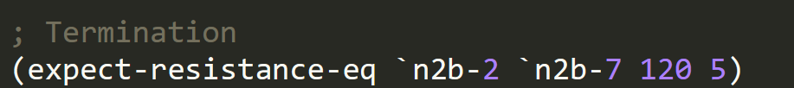
Real test examples: CAN Terminator
Connects control box ground
Power is OFF!
Measures resistance end to end

Slide 28
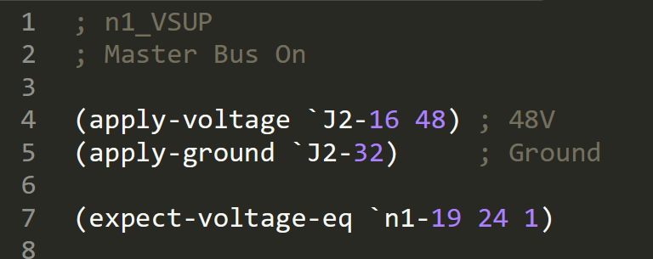
Real test examples: Voltage test
Turn the control box ON
Measures voltage on one of 24V pins on master bus

Slide 29
Minimum requirements to build a test
Voltage measurement
Resistance measurement
Arbitrary voltage source
Current measurement (rare)
Being able to construct arbitrary circuits

Slide 30
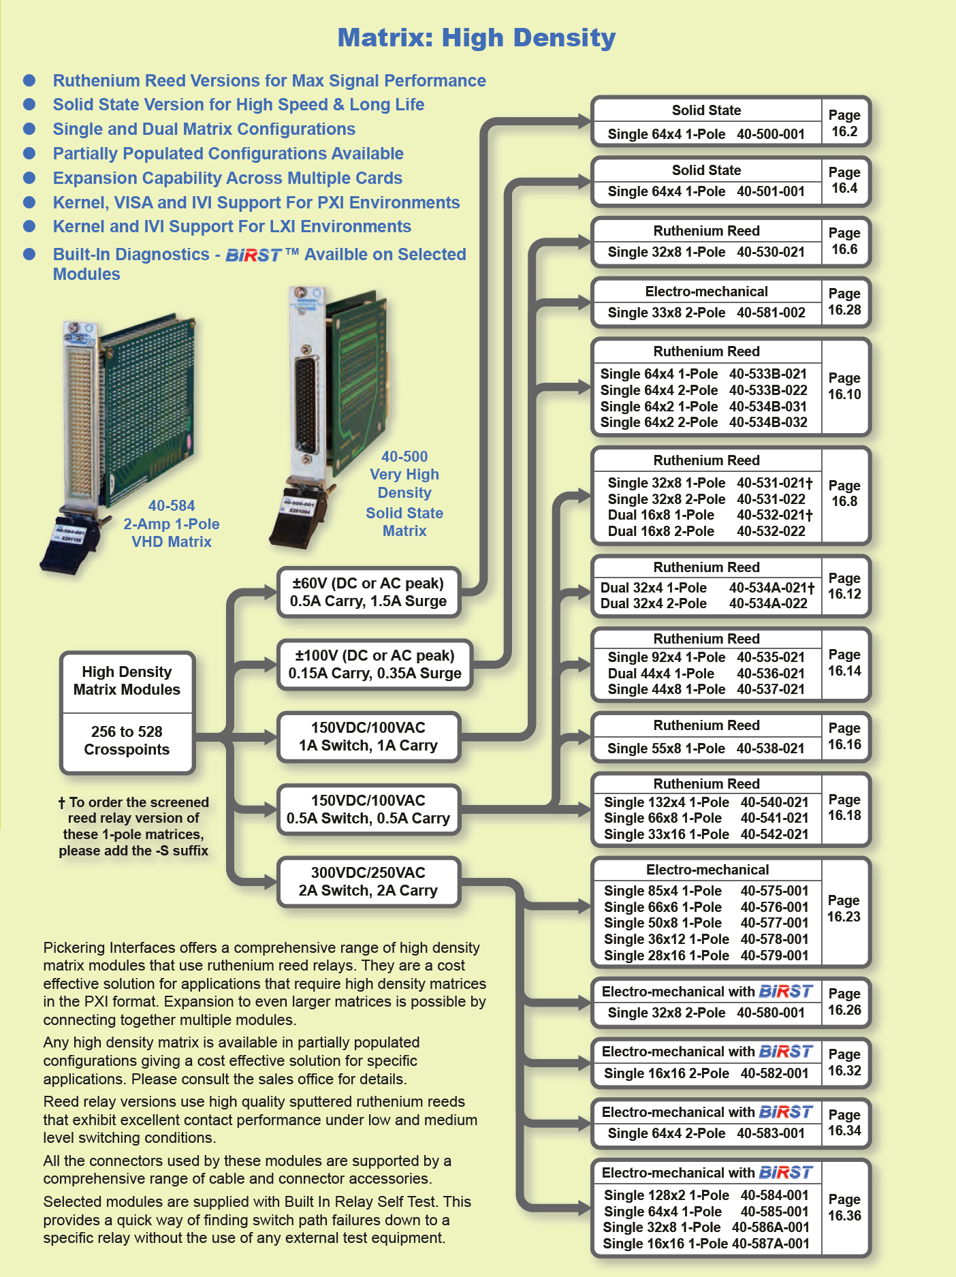
Pickering catalog

Slide 31
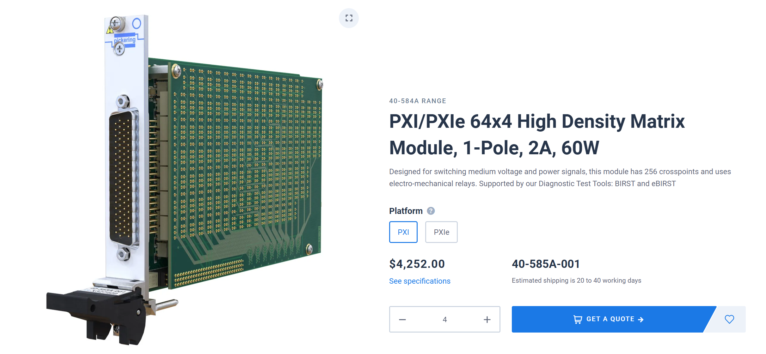
4x64 Matrix Option from Pickering
Having 4 rows in Y-axis is very limiting
Need x4 modules for 256 targets on X axis
2A current

Slide 32
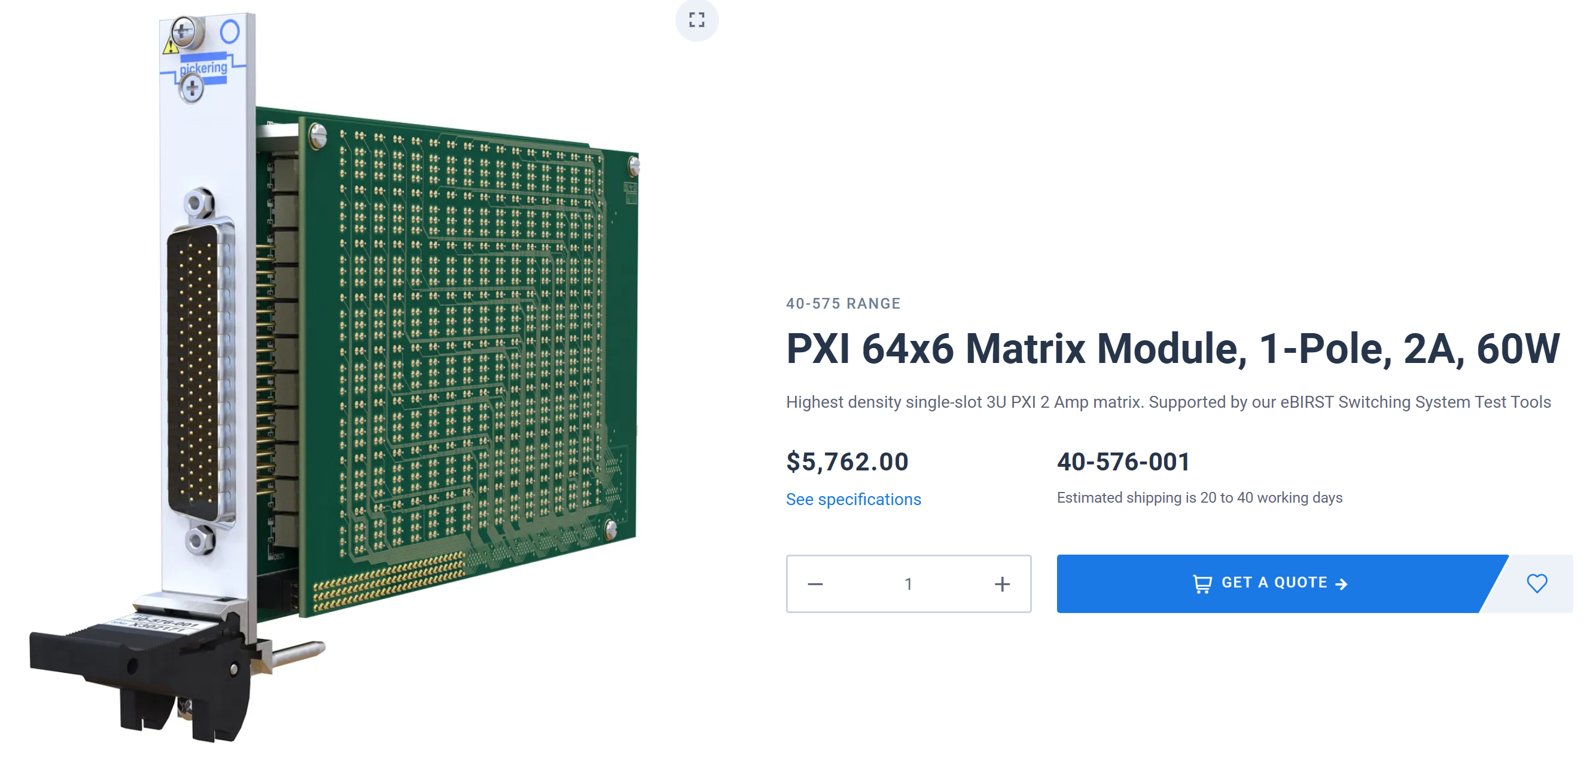
6x64 Matrix Option from Pickering
Having 6 rows is useful
Need x4 modules for 256 targets on X axis
2A current

Slide 33

6x64 Matrix Option from Marvin
Having 6 rows in Y-axis is nice
Still need x4 modules for 256 targets on X axis
Only 500 mA current

Slide 34
Minimum requirements to build a test
Voltage measurement
Resistance measurement
Arbitrary voltage source
Current measurement (rare)
Being able to construct arbitrary circuits
Notes:
First, those are minimum requirements to write tests. You want to measure voltage and resistance. Ideally, we would always measure resistance because it is more accurate, but it’s not always possible. Measuring an open ciruit voltage on a pin, for example, tells you that it’s the correct potential, but does not tell you if it’s a high resistance connection (poor crimp, not seated terminal, etc…). Resistance test is more accurate, but it may not be possible because we don’t have access to both ends of the wire, or if there’s current going through the wire. Voltage measurement is used to test relays outputs, where as resistance measurement is used from grounds, and in places where we have access to both ends of the wire. There’s an additional requirement here: an arbitrary adjustable voltage source. This is important, because it can make it very easy to build tests if you could generate an arbitrary voltage on command. In circuit analysis, a test voltage source is an important measurement tool that can be used to characterize a circuit. For example, you may apply a test voltage source and measure current to find out impedance. Current measurement may be important for testing certain components, such as verifying sensor current sources, measuring output or input impedance, estimating power consumption. It’s important when you need it, but for Tiger may be optional. Last requirement, you want to be able to construct arbitrary test circuits in software. In this is the topic of the next series of slides.

Slide 35
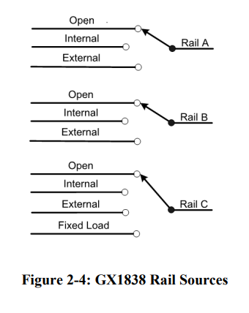

PXI Power Supply
Possible candidate for adjustable power supply
500 mA, up to 32V
Ideal test signal source
Not great for switching large relays

Slide 36

PXI Power Supply
2 Channel
2A, 48V
Great, but could use more channels

Slide 37

PXI SMUs: Precision Sources
Higher-precision sources are called SMU (Source Measure Units)
Typically, low voltages/currents

Slide 38
Minimum requirements to build a test
Voltage measurement
Resistance measurement
Arbitrary voltage source
Current measurement (rare)
Being able to construct arbitrary circuits
Notes:
First, those are minimum requirements to write tests. You want to measure voltage and resistance. Ideally, we would always measure resistance because it is more accurate, but it’s not always possible. Measuring an open ciruit voltage on a pin, for example, tells you that it’s the correct potential, but does not tell you if it’s a high resistance connection (poor crimp, not seated terminal, etc…). Resistance test is more accurate, but it may not be possible because we don’t have access to both ends of the wire, or if there’s current going through the wire. Voltage measurement is used to test relays outputs, where as resistance measurement is used from grounds, and in places where we have access to both ends of the wire. There’s an additional requirement here: an arbitrary adjustable voltage source. This is important, because it can make it very easy to build tests if you could generate an arbitrary voltage on command. In circuit analysis, a test voltage source is an important measurement tool that can be used to characterize a circuit. For example, you may apply a test voltage source and measure current to find out impedance. Current measurement may be important for testing certain components, such as verifying sensor current sources, measuring output or input impedance, estimating power consumption. It’s important when you need it, but for Tiger may be optional. Last requirement, you want to be able to construct arbitrary test circuits in software. In this is the topic of the next series of slides.

Slide 39
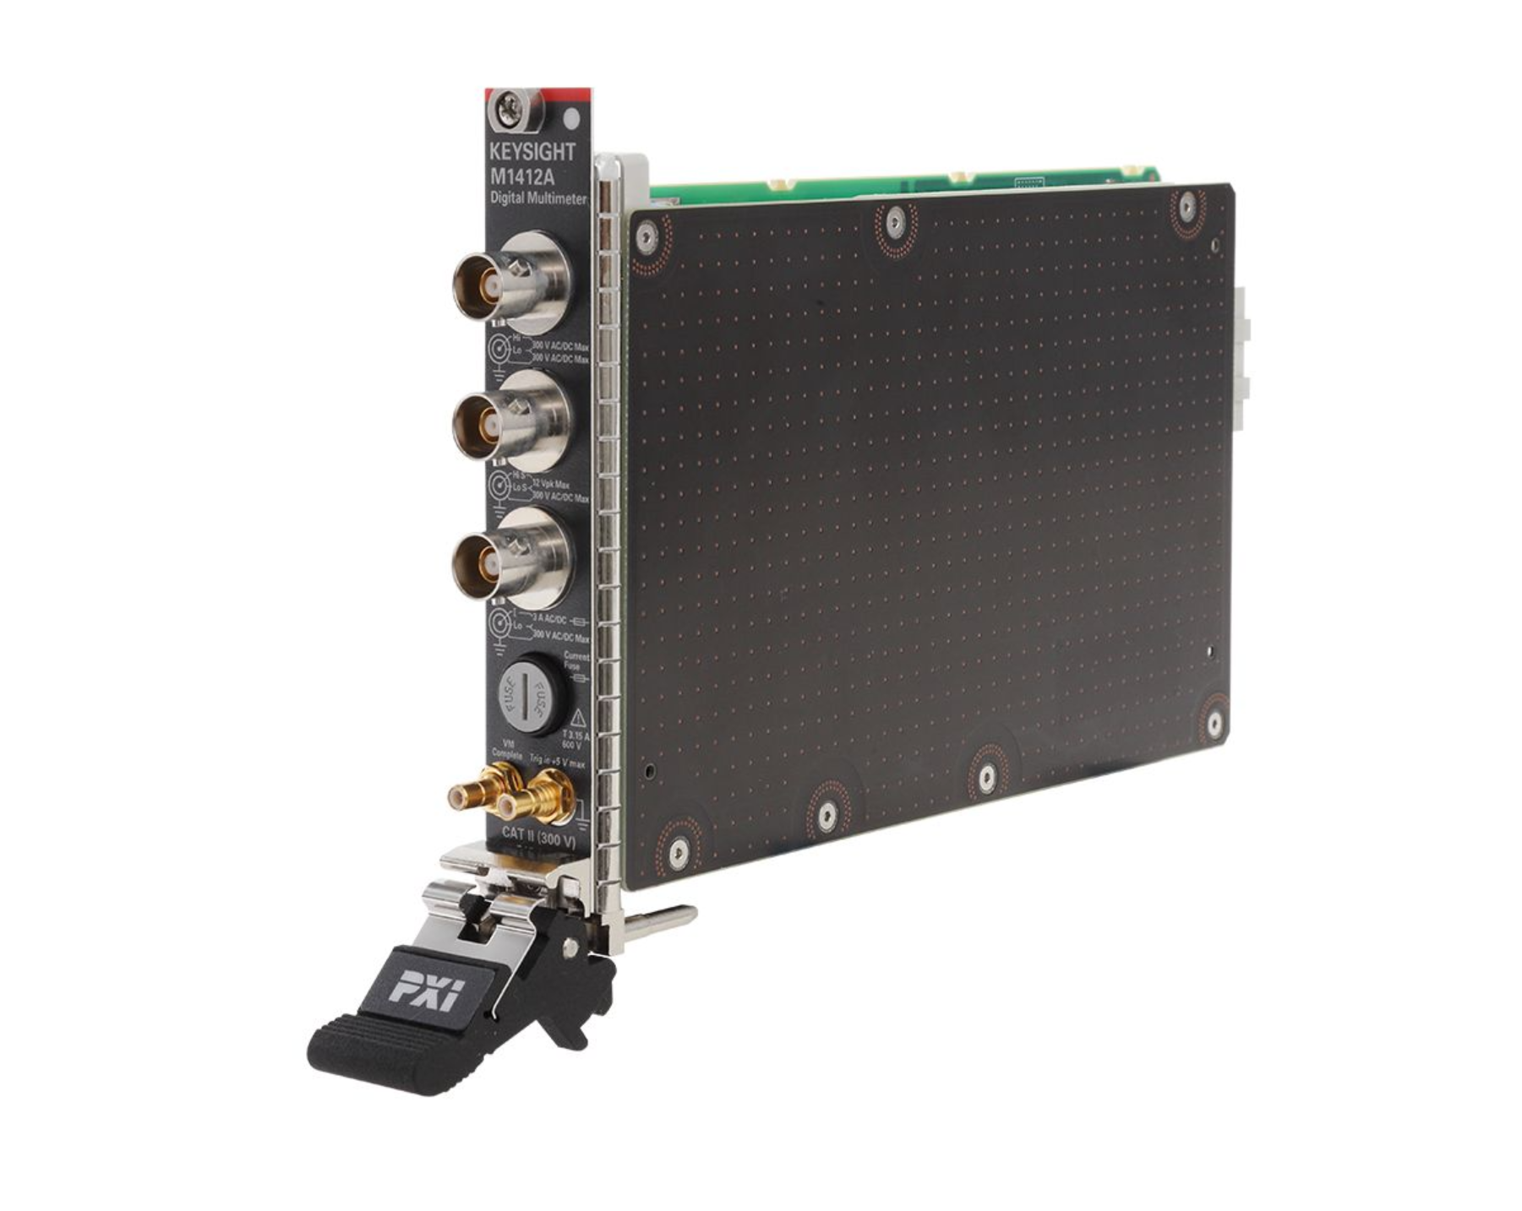

PXI DMM (Digital Multimeters): M1212A – High End
M1412A
7.5 Digit
Costs $8793
Notes:
Keysight is known for making high-end oscilloscopes and other lab test and measurement equipment.

Slide 40

PXI DMM (Digital Multimeters): Other options from Keysight

Slide 41
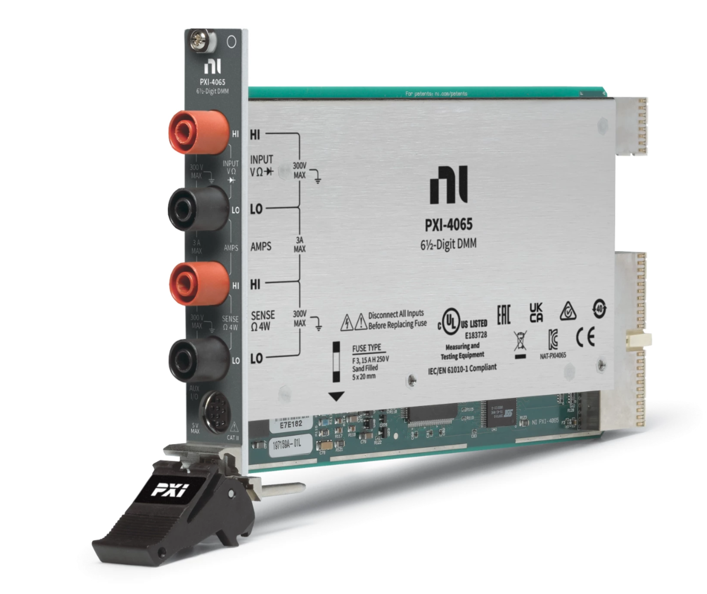
PXI DMM (Digital Multimeters): NI PXI-4065
6.5 Digit
Costs $2085

Slide 42
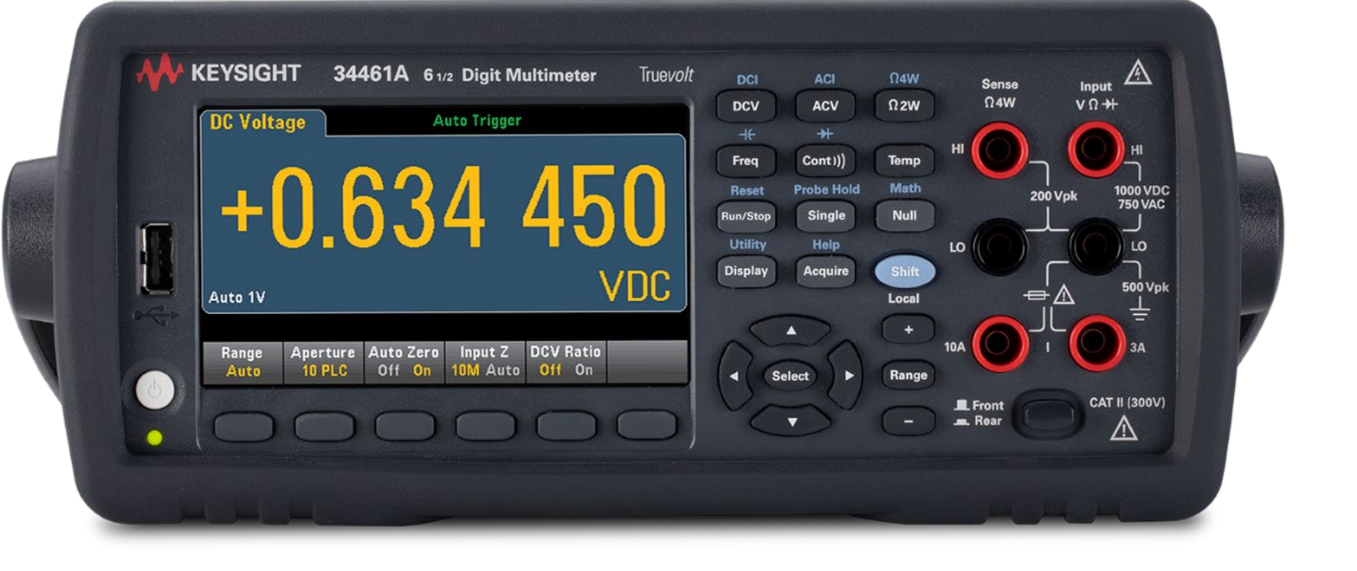
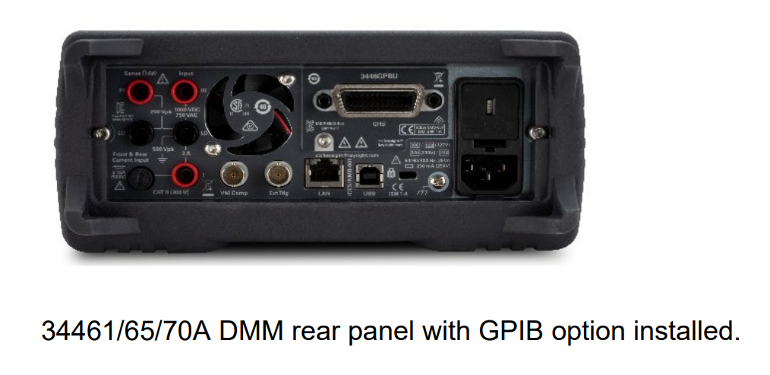
Bench Top DMM (Digital Multimeters): Other options from Keysight
6.5 Digit
Ethernet, USB
Rear probe jacks
Costs $1865

Slide 43
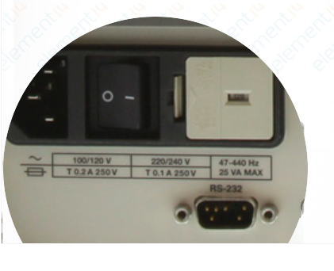
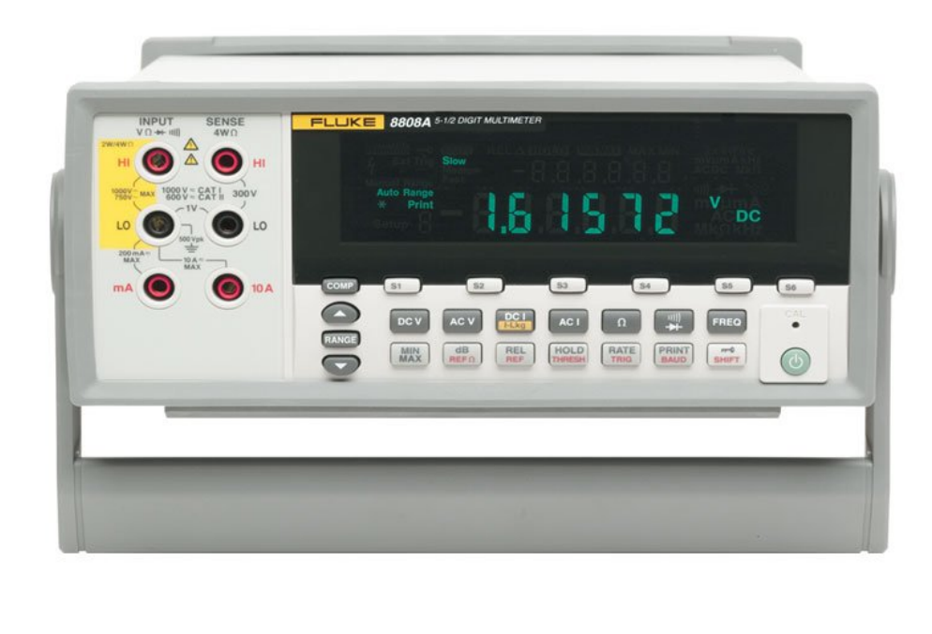
Bench Top DMM (Digital Multimeters): And then there’s Fluke
5.5 Digit
Ethernet, USB Serial
Rear probe jacks
Costs $1360

Slide 44
Summary
Rough wish list so far:
Matrix modules
Four 4x64 modules
6x64 preferred
Need some with 2A capacity for power and large relays
Signal can be 500mA capacity or less
Voltage source
x1 3 rail test source supply 500mA general
x1 high-power power supply 2A capability up to 48V for switching large relays and power input
DMM
Chassis
PC-based if possible

